Slide 1
Minimization
A circuit/expression is minimum iff :
  Least # of gates; least # of inputs (if same # of gates); least # of interconnections between gates; least # of levels; least # of IC packages (chips); uses smallest silicon area in fabrication
Minimization methods
  Algebraic Minimization/Simplification
  Karnaugh Map
  Quine-McCluskey Method (Function Minimization Algorithms)

Slide 2
Karnaugh Map
Introduced by Maurice Karnaugh in 1953.
K-map consists of one square for each possible minterm in a function.
  n variables have 2^{n} minterm.
  n-variable K-map has 2^{n} squares.
Two-Variable Karnaugh Map
a
b
0
1
a’b’
ab’
m₀
m₂
0
0
2
a’b
ab
m₁
m₃
1
1
3

Slide 3
Two-Variable Karnaugh Map
a
a
b
0
1
b
0
1
0
1
0
1
X
1
1
1
0
1
f(a,b) = ∑m(0, 3)
f(a,b) = ∑m(0, 3)+ ∑d(2)

Slide 4
Two-Variable Karnaugh Map
a
b
0
1
F(a, b) = ∑m(2, 3)
= ab’ + ab
= a(b’+b)
= a•1
= a
0
0
1
1
0
1
a
b
0
1
F(a, b) = ∑m(0,1,2, 3)
= a’b’+a’b+ab’+ab
= a’(b’+b)+a(b’+b)
= a’+a
= 1
0
1
1
1
1
1

Slide 5
Three-Variable Karnaugh Map
ab
b
c
00
01
11
10
The last two columns are
not in numeric order —
key idea of K-map.
Only one literal is different between two adjacent squares and one is the complement of another.
The minterms in adjacent squares can always be combined using ab+ab’=a
0
a’b’c’
a’bc’
abc’
ab’c’
1
a’b’c
a’bc
abc
ab’c
c
ab
a
c
00
01
11
10
0
0
2
6
4
1
1
3
7
5

Slide 6
Three-Variable Karnaugh Map
ab
c
00
01
11
10
m0+m1 = a’b’c’+a’b’c = a’b’(c’+c) = a’b’•1 = a’b’
0
1
1
1
m2+m6 = a’bc’+abc’ = (a’+a)bc’ = 1•bc’ = bc’
ab
c
00
01
11
10
0
1
1
m1+m5 = a’b’c+ab’c = (a’+a)b’c = 1•b’c = b’c
1
1
1

Slide 7
Example
xy
z
00
01
11
10
0
1
1
x’yz’+x’yz+xy’z’+xy’z+xyz
1
1
1
1
xy
z
00
01
11
10
0
1
1
= (x’yz’+x’yz)+(xy’z’+xy’z)+xyz
= x’y + xy’ + xyz
1
1
1
1

Slide 8
Example
xy
z
00
01
11
10
0
1
1
= (x’yz’+x’yz)+(xy’z’+xy’z)+(xyz+xy’z)
= x’y + xy’ + xz
1
1
1
1
xy
Minimum solutions
z
00
01
11
10
0
1
1
= (x’yz’+x’yz)+(xy’z’+xy’z)+(xyz+x’yz)
= x’y + xy’ + yz
1
1
1
1

Slide 9
Example
ab
c
00
01
11
10
0
1
1
1
a’b’c’ + a’bc’ + a’bc + ab’c’
= (a’b’c’+a’bc’) + a’bc + ab’c’
= a’c’ + a’bc + ab’c’
1
1
ab
c
00
01
11
10
0
1
1
1
a’b’c’ + a’bc’ + a’bc + ab’c’
= (a’b’c’+ab’c’) + (a’bc’+a’bc)
= b’c’ + a’b
1
1

Slide 10
Definitions
Implicant
  A product term that can be used in a sum of products expression for the function.
Prime implicant
  An implicant that is not fully contained in any other implicant.
Essential prime implicant
  A prime implicant that includes at least one 1 that is not included in any other prime implicant.

Slide 11
Example
f(A,B,C,D)=Σm(0,5,7,8,12,14)
  PIs: 7
  Essential cells:

Slide 12
Four-Variable Karnaugh Map
b
ab
ab
cd
00
01
11
10
cd
00
01
11
10
00
a’b’c’d’
a’bc’d’
abc’d’
ab’c’d’
00
0
4
12
8
01
a’b’c’d
a’bc’d
abc’d
ab’c’d
01
1
5
13
9
d
11
a’b’cd
a’bcd
abcd
ab’cd
11
3
7
15
11
c
10
a’b’cd’
a’bcd’
abcd’
ab’cd’
10
2
6
14
10
a

Slide 13
Adjacencies on K-map
1
1

Slide 14
Implicant vs. Prime Implicant
ab
ab
cd
00
01
11
10
cd
00
01
11
10
00
1
1
00
1
1
01
1
01
1
11
1
1
1
1
11
1
1
1
1
10
10

Slide 15
Example
ab
cd
00
01
11
10
Prime implicant
a’c’, bd
abc, acd’, ab’d’, b’c’d’
00
1
1
1
01
1
1
1
Essential prime implicant
a’c’, bd
11
1
1
10
1
1

Slide 16
PI vs. Essential PI
ab
ab
cd
00
01
11
10
cd
00
01
11
10
00
1
1
00
1
1
01
1
01
1
11
1
1
1
1
11
1
1
1
1
10
10

Slide 17
Four-Variable Karnaugh Map
ab
m4+m6
= a’bc’d’+a’bcd’
= a’bd’(c’+c)
= a’bd’•1
= a’bd’
cd
00
01
11
10
00
1
01
1
1
11
m1+m9
= a’b’c’d+ab’c’d
= (a’+a)b’c’d
= 1•b’c’d
= b’c’d
10
1

Slide 18
Four-Variable Karnaugh Map
ab
m13+m9
= abc’d+ab’c’d
= ac’d(b+b’)
= ac’d•1
= ac’d
cd
00
01
11
10
00
01
1
1
m7+m6
= a’bcd+a’bcd’
= a’bc(d+d’)
= a’bc•1
= a’bc
11
1
10
1

Slide 19
Groups of Four Minterms
ab
ab
c
00
01
11
10
c
00
01
11
10
0
0
1
1
1
1
1
1
1
1
1
1
a’b’c+a’bc
=a’c(b’+b)
=a’c
abc+ab’c
=ac(b+b’)
=ac
a’c+ac
=c(a’+a)
=c
a’b’c+a’bc+abc+ab’c = c(a’b’+a’b+ab+ab’) = c•1 = c
a’b’+a’b+ab+ab’ =1 (a’+b’)(a’+b)(a+b)(a+b’) = 1

Slide 20
Groups of Four Minterms
ab
b
ab
cd
00
01
11
10
cd
00
01
11
10
00
1
00
01
1
1
1
01
1
1
d
11
1
1
1
11
1
1
c
10
1
10
a
a’b’
ad
b’d

Slide 21
Groups of Four Minterms
b
ab
cd
00
01
11
10
00
1
1
01
1
1
d
11
1
1
c
10
1
1
a
b’d’
bd

Slide 22
Groups of Eight Minterms
b
ab
ab
cd
00
01
11
10
cd
00
01
11
10
00
1
1
00
1
1
1
1
01
1
1
01
d
11
1
1
11
c
10
1
1
10
1
1
1
1
a
a’
d’

Slide 23
Find the Minimum SOP
Map method 1
  Find all essential prime implicants, starting with the most isolated 1’s. Mark the minterms that make them essential with asterisk(*).
  Find enough other prime implicants to cover the function
    Choose a prime implicant that covers as many new 1’s
    Avoid leaving isolated uncovered 1’s

Slide 24
Example
ab
ab
cd
00
01
11
10
cd
00
01
11
10
00
1
1
1
1
00
2
3
2
2
01
1
01
2
11
1
1
1
11
2
2
1
10
10
c’d’ + a’bd + acd
single solution

Slide 25
Example
ab
cd
00
01
11
10
cd
00
01
11
10
00
1
00
1
01
1
1
1
01
3
3
1
11
1
1
1
11
1
3
3
10
1
10
1
a’bc’ + a’cd + abc + ac’d

Slide 26
Find the Minimum SOP
Map method 2
  Circle all of the prime implicants
  Select all essential prime implicants that have at least one 1’s that have been circled only once
  Then choose enough of the other prime implicants to cover the function

Slide 27
Example
ab
ab
ab
cd
00
01
11
10
cd
00
01
11
10
cd
00
01
11
10
00
00
00
01
2
3
2
*
*
*
*
01
1
1
1
01
1
1
1
11
3
3
3
11
1
1
1
11
1
1
1
10
2
2
2
10
1
1
1
10
1
1
1
All prime implicants
Essential prime implicants

Slide 28
Example (Cont’d)
ab
ab
ab
cd
00
01
11
10
cd
00
01
11
10
cd
00
01
11
10
00
00
00
*
*
*
*
*
*
01
1
1
1
01
1
1
1
01
1
1
1
11
1
1
1
11
1
1
1
11
1
1
1
10
1
1
1
10
1
1
1
10
1
1
1
bd+ad+a’cd’+ab’c
bd+ad+a’cd’+b’cd’
bd+ad+b’cd’+a’bc
Multiple results

Slide 29
Find the Minimum POS
Recall: get the POS of function F using algebra method
  Get complement function F ’
  Get the SOP of function F ’
  Complement the SOP of F ’ and get the POS of F
Using K-map
  Map the complement of the function. (Replace all 0’s by 1’s, all 1’s by 0’s.)
  Find the minimum sum of products expression for the complement of the function
  Complement that expression, producing a product of sums expression

Slide 30
Example
ab
ab
cd
00
01
11
10
cd
00
01
11
10
00
1
1
00
1
1
01
1
1
0 to 1
01
1
1
11
1
1 to 0
11
1
1
1
10
1
1
10
1
1
F=(a’+c)(a+c’)(a’+b’+d’)
F=(a’+c)(a+c’)(b’+c’+d’)
F’=ac’+a’c+abd
F’=ac’+a’c+bcd

Slide 31
Don’t cares
Implicant:
  A rectangle in which the number of squares is a power of 2.
  That rectangle cannot contain any 0’s. This means that an implicant is allowed to cover X’s.
Prime implicant:
  An implicant that is not fully contained in any other implicant.
Essential prime implicant:
  A prime implicant that includes at least one “1” that is not included in any other prime implicant.
  X’s that are not covered by other prime implicants do NOT make a prime implicant essential.

Slide 32
Example
ab
ab
cd
00
01
11
10
cd
00
01
11
10
00
X
00
X
*
*
01
1
X
1
01
1
X
1
*
11
1
X
1
11
1
X
1
10
1
10
1
Prime implicants
F=bd+a’c’d+ab’c

Slide 33
Example
ab
cd
00
01
11
10
cd
00
01
11
10
00
X
1
X
X
00
X
1
X
X
01
1
X
01
1
X
11
1
1
11
1
1
*
10
1
X
10
1
X
Prime implicants

Slide 34
Example(Cont’d)
ab
cd
00
01
11
10
cd
00
01
11
10
cd
00
01
11
10
00
X
1
X
X
00
X
1
X
X
00
X
1
X
X
01
1
X
01
1
X
01
1
X
11
1
1
11
1
1
11
1
1
*
*
10
1
X
10
1
X
10
1
X
a’bd’ + a’b’c’ + b’cd
= 1 if abcd=0000
= 0 if abcd=1010
a’bd’ + a’b’d + b’cd
= 0 if abcd=0000
= 0 if abcd=1010
a’bd’ + a’b’d + ab’c
= 0 if abcd=0000
= 1 if abcd=1010

Slide 35
More Examples
f(x,y,z)=xy + x’y’z
F(A,B,C)=(A’+C’)(A’+AB’)
f(A,B,C,D)= Σm(0,2,10,11,12,14)
f(w,x,y,z)= Σm(1,5,6,7,11,12,13,15)
f(A,B,C,D)= Σm(0,2,8,12,13)
f(A,B,C,D)= ΠM(7,9,13)
f(A,B,C,D)= Σm(4,6,9,10,11,12,13,14)+
Σd(2,5,7,8)

Slide 36
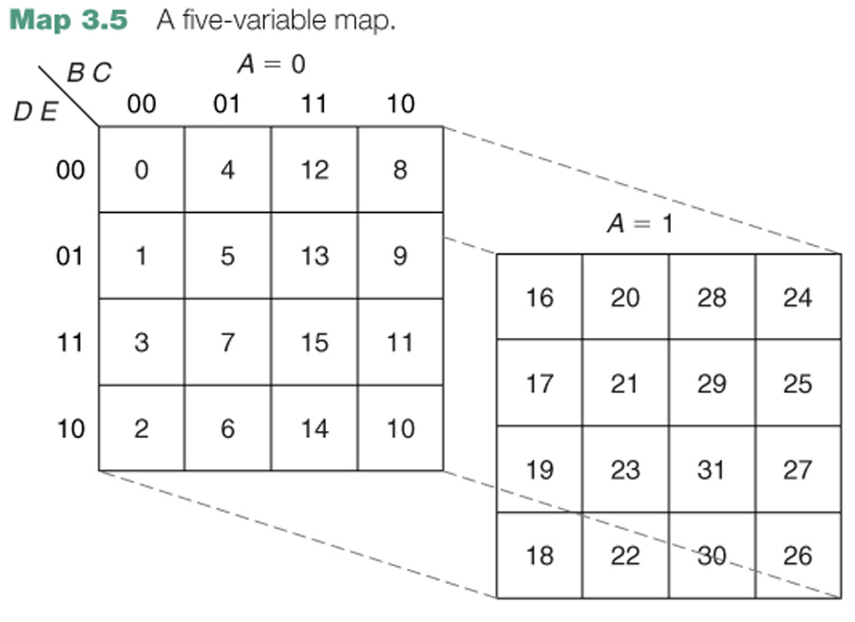
Five-variable K-map

Slide 37
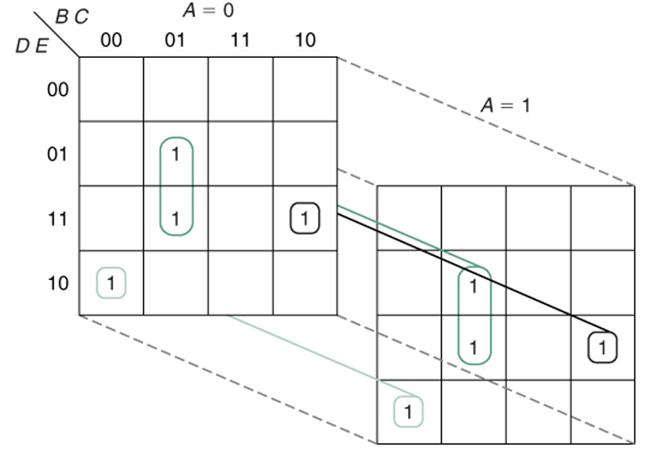
Example

Slide 38
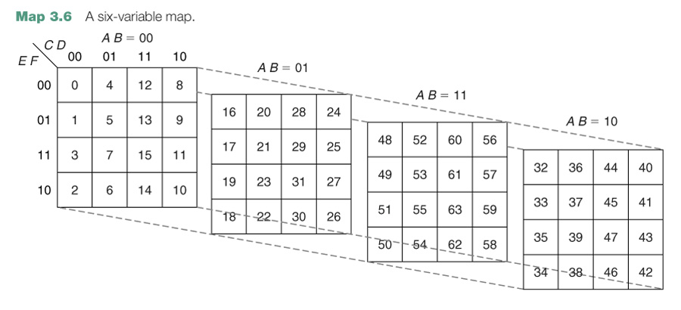
Six-variable K-map

